Slide 1


ArcGIS API for Python for Data Scientists
Andrew Chapkowski
Alberto Nieto
2018 Esri Developer Summit DC

Slide 2

Agenda
Introduction
ArcGIS platform
Analysis
Spatial DataFrame
Tensor Flow Demo
Using ArcGIS for Data Science

Slide 3

Introduction

Slide 4

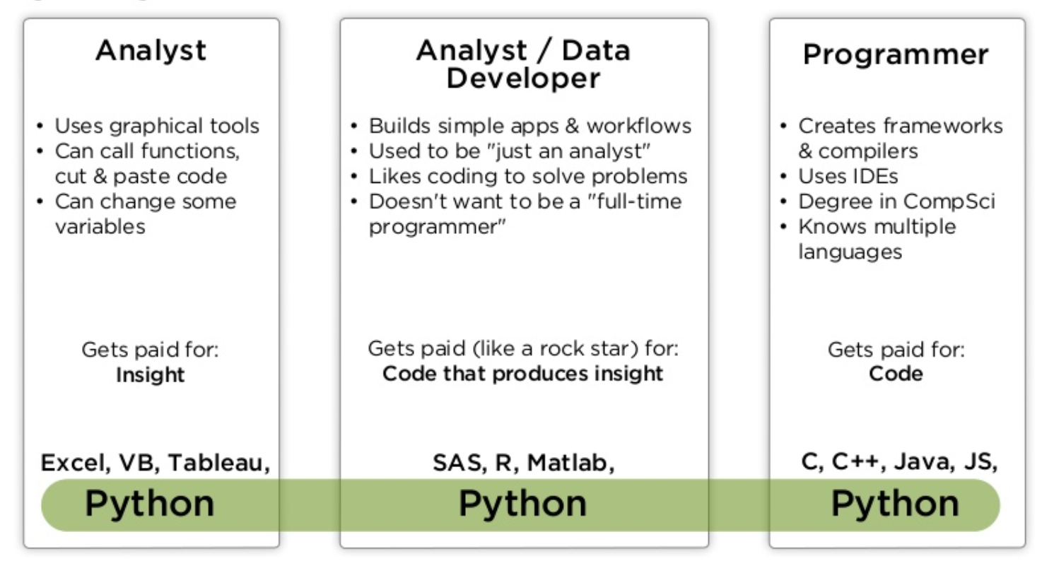
Analysts, Data Scientists and Developers
Source: PyCon India 2018 Python And Data: Past, Present And Future By Peter Wang

Slide 5
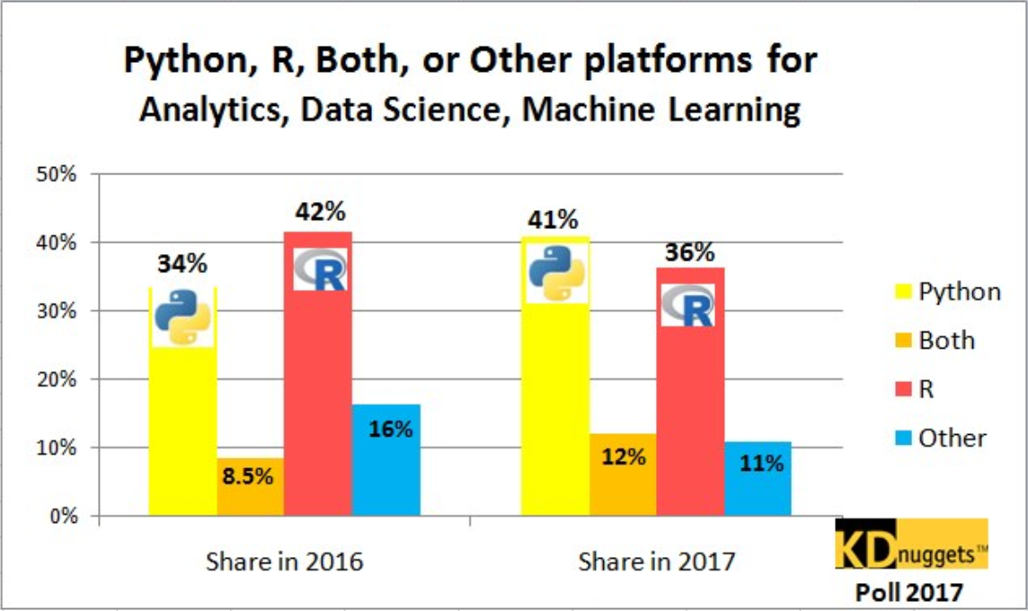

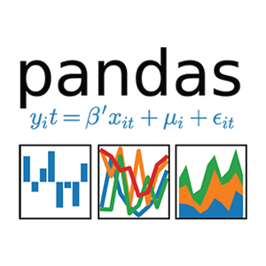





Why Python?
Popularity
Productivity
Interoperability
Solves the “two language” problem
Scientific Python ecosystem
Community

Slide 6
Analysis

Slide 7
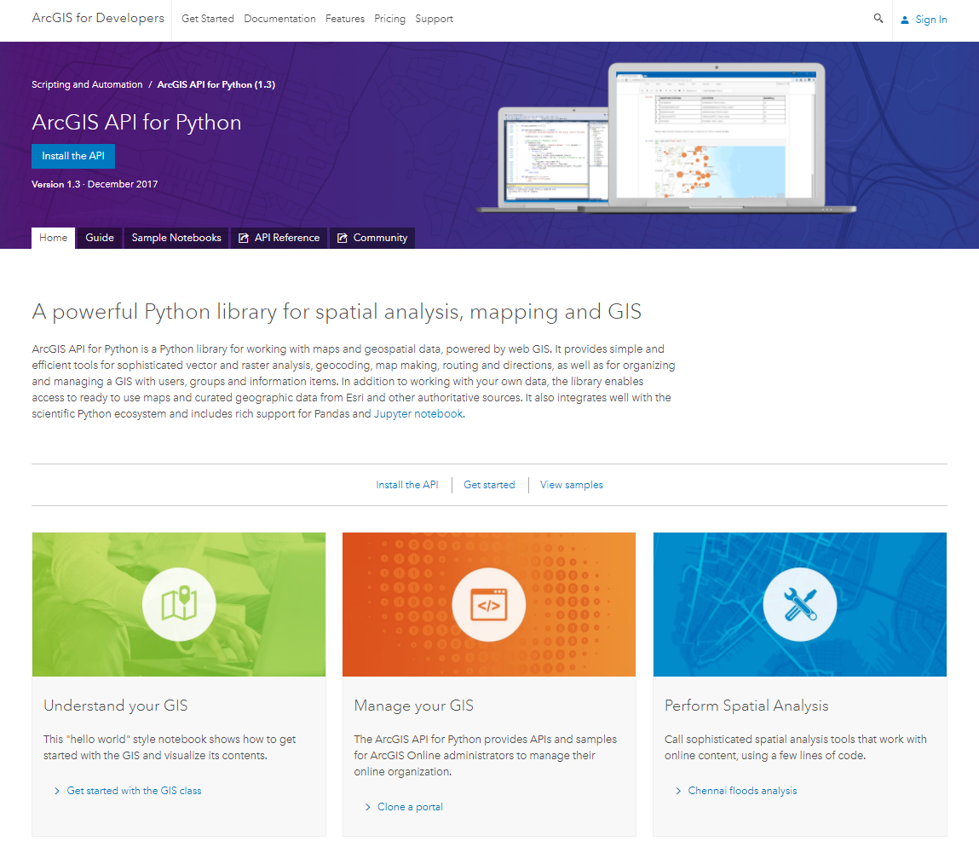

geo
enrichment
widgets
geometry
mapping
gis
geo
processing
geocoding
geo
analytics
realtime
schematics
raster
network
features

Slide 8
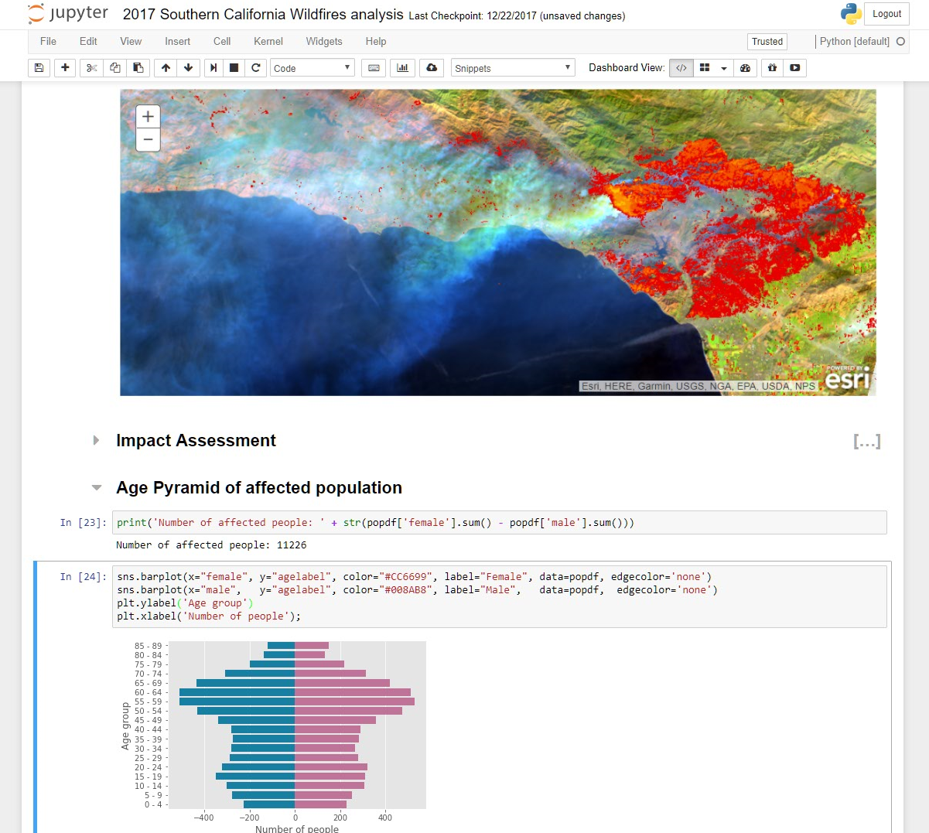
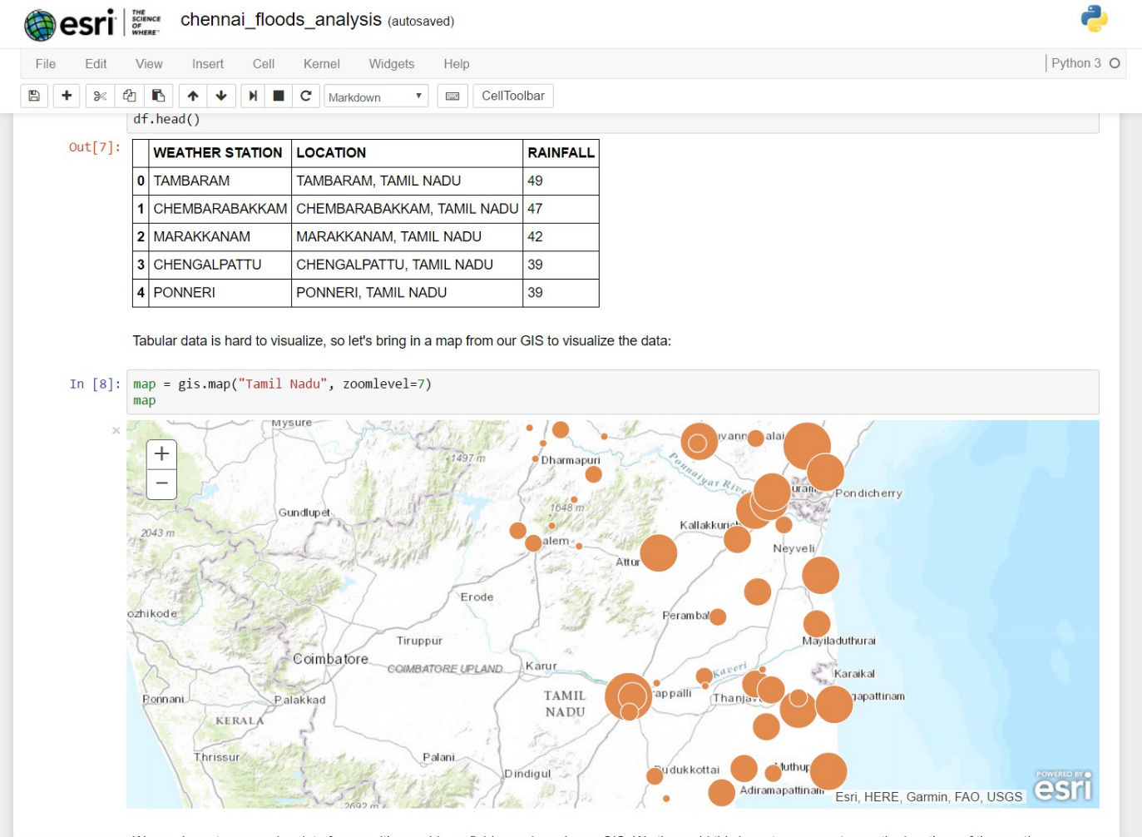
ArcGIS + Jupyter = ♥

Slide 9
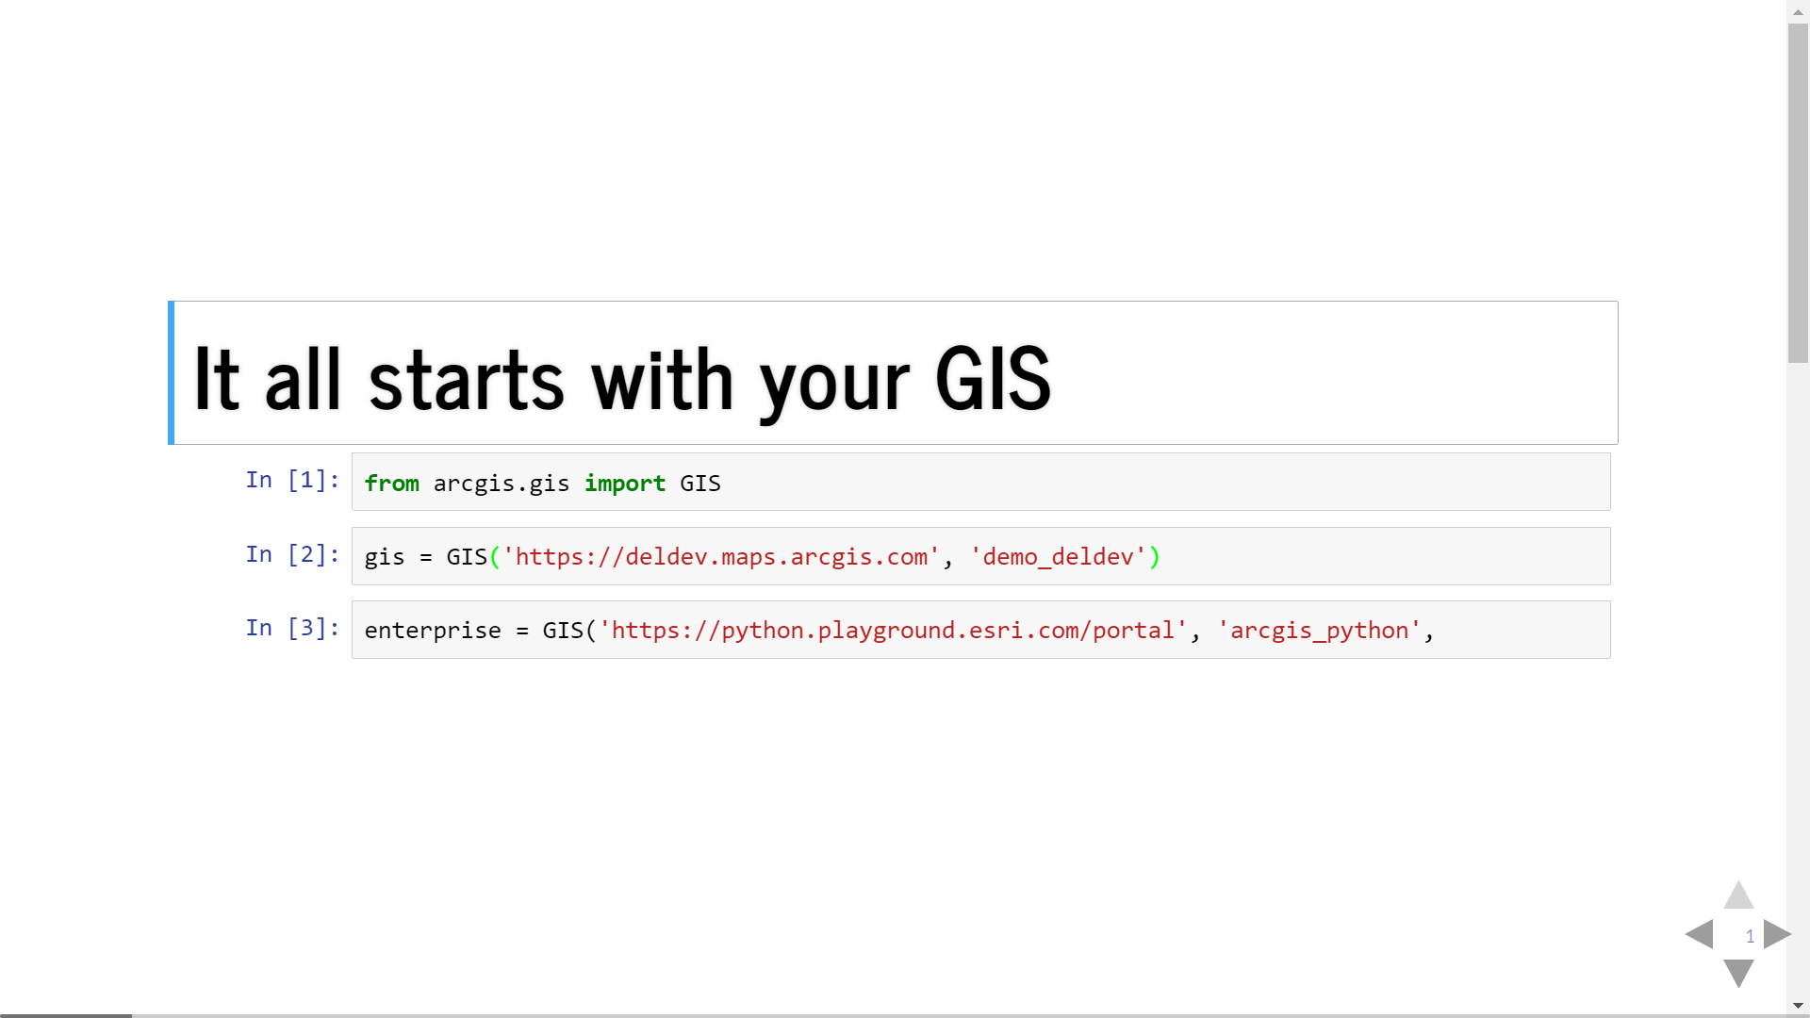

Slide 10
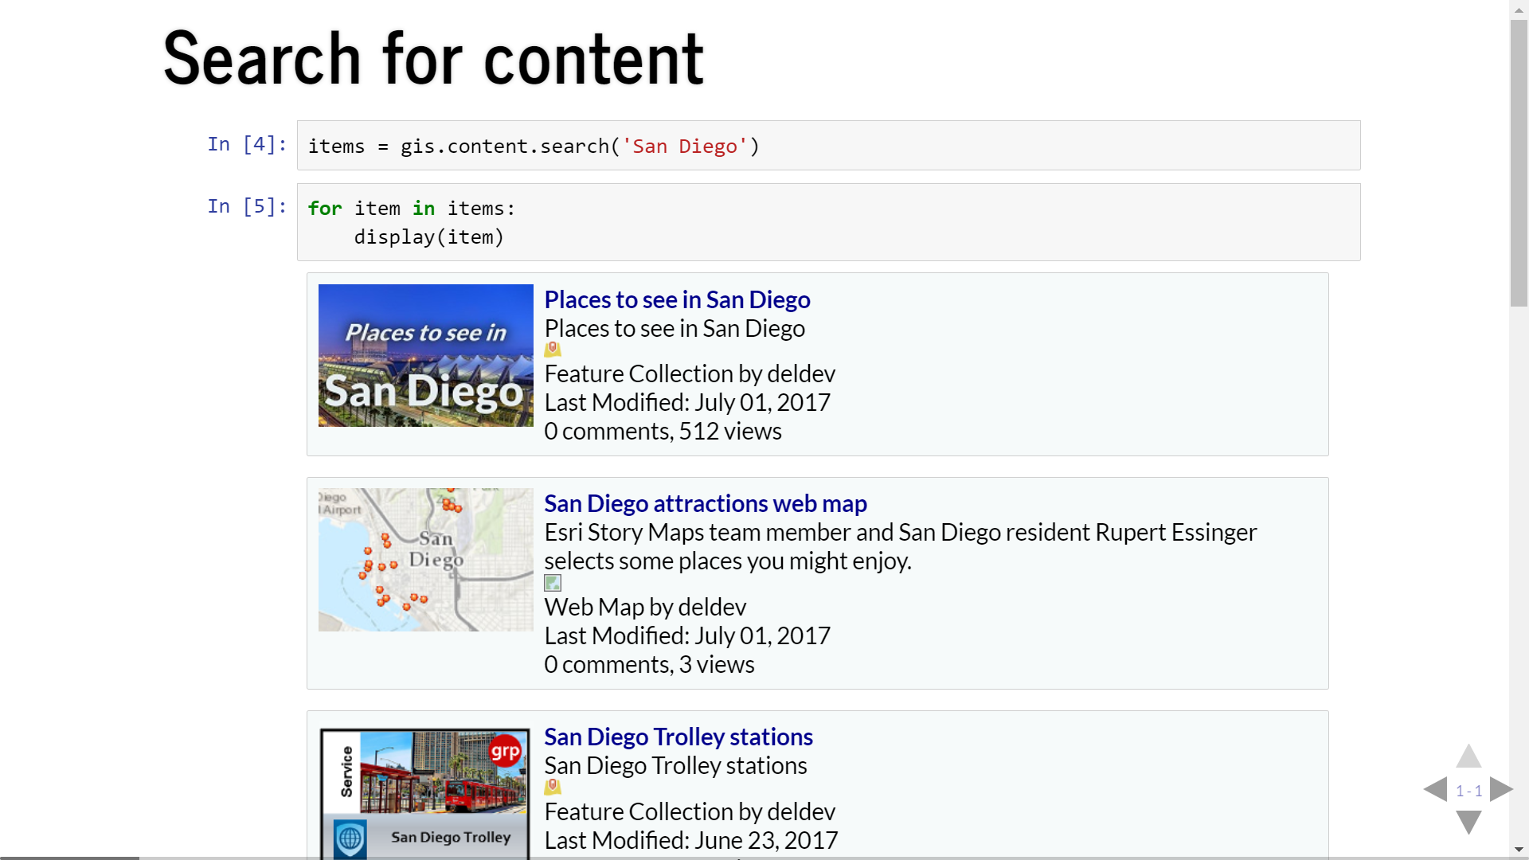

Slide 11
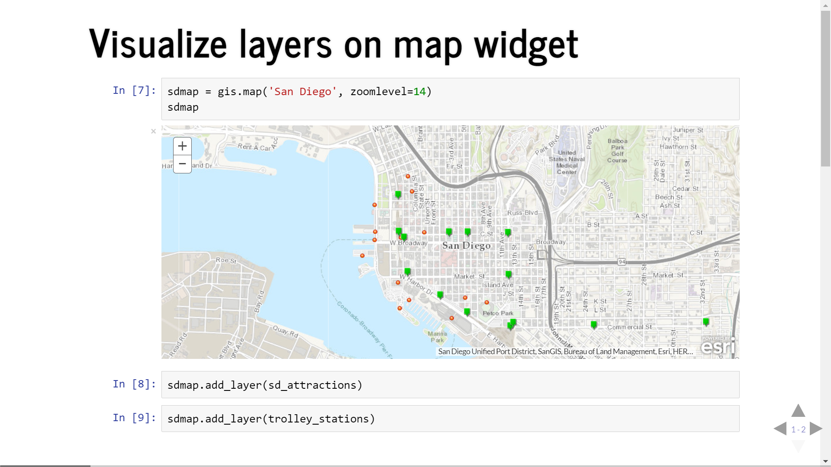

Slide 12
Spatial Analysis
Discover relationships, patterns and trends in data
arcgis.feature submodules

Slide 13
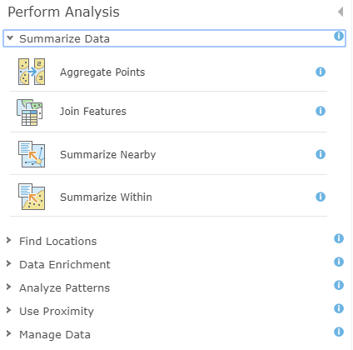
Spatial Analysis Tools
Summarize Data
Find Locations
Data Enrichment
Analyze Patterns
Use Proximity
Manage Data

Slide 14
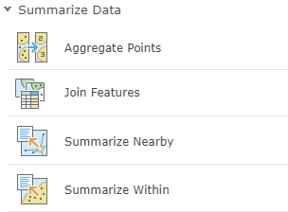
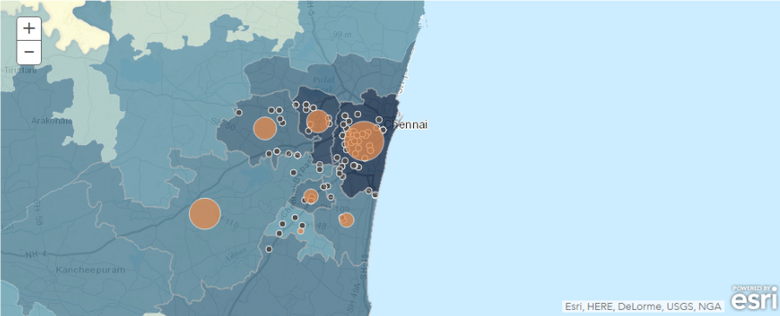
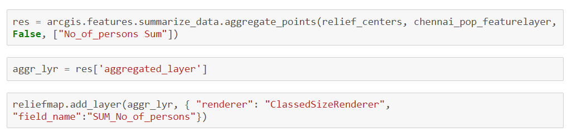
Summarize Data
Calculate summary statistics for features and attributes

Slide 15
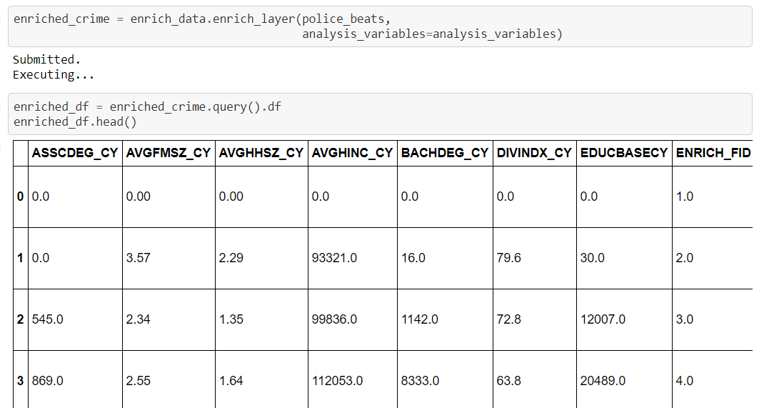
Enrich Layer
Add detailed demographic data and statistics to your analysis

Slide 16
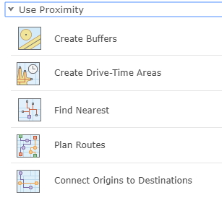
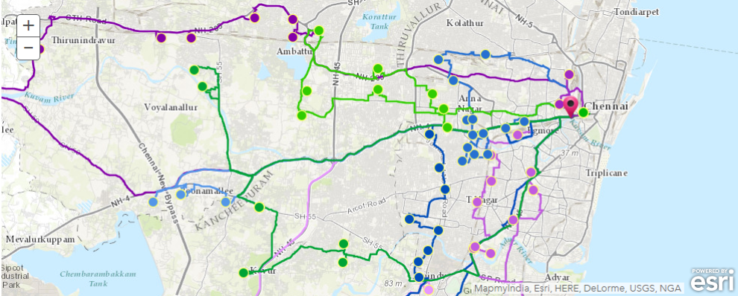
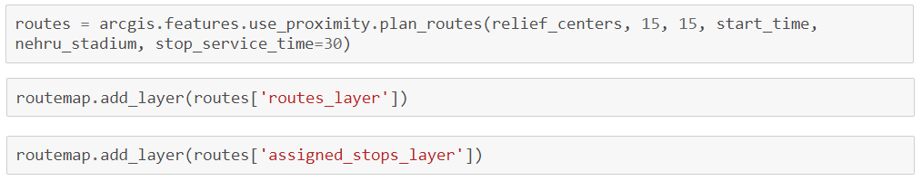
Use Proximity
“What is near what?”

Slide 17
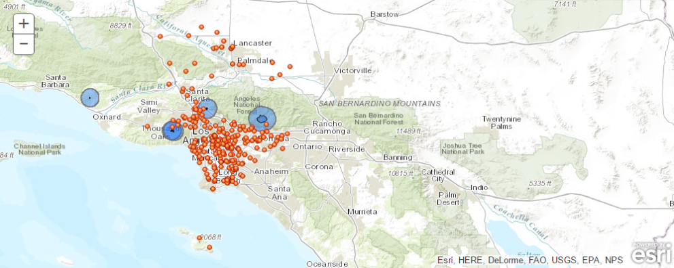
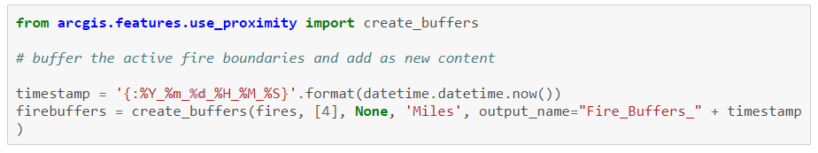
Use Proximity
“What is near what?”

Slide 18
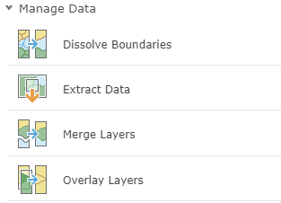
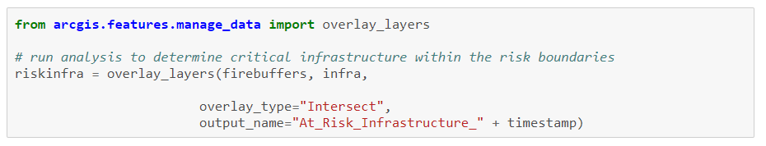
Manage Data
Manage geographic data, overlay layers

Slide 19
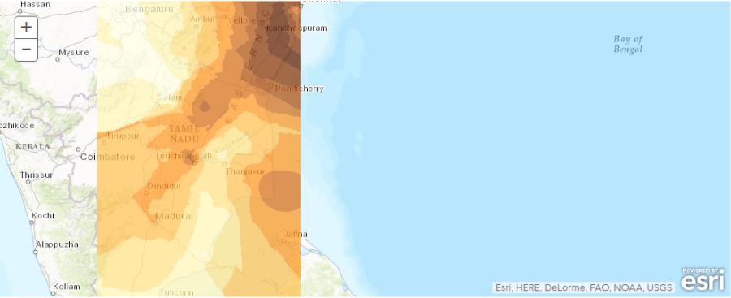
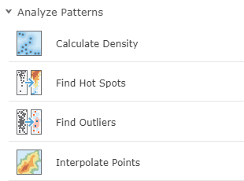
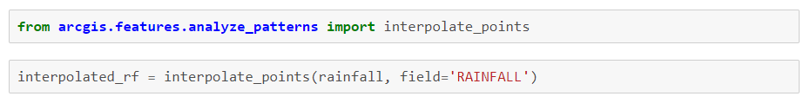
Analyze Patterns
Identify, quantify, and visualize spatial patterns in your data.

Slide 20
Geocoding
Geocoding, Batch geocoding, reverse geocoding
arcgis.geocoding module

Slide 21
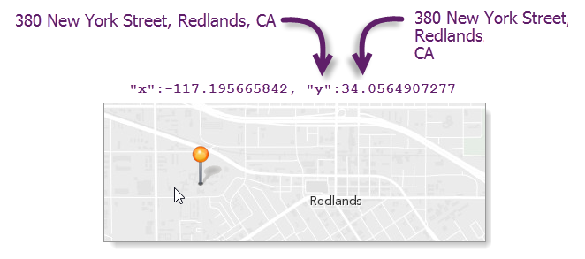
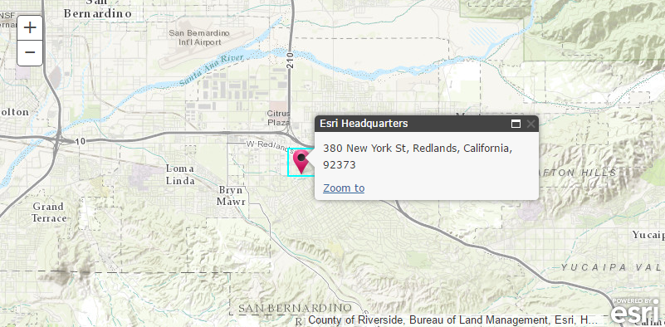
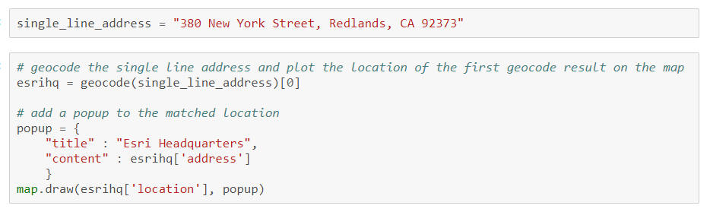
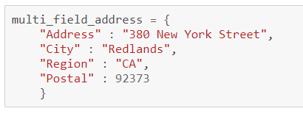
Geocode
Single line or multi field addresses

Slide 22
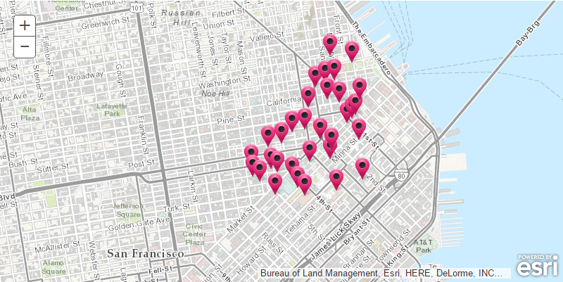
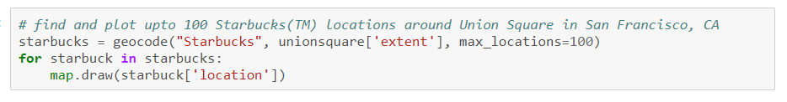
Geocode
Points of Interest
Cultural or geographic landmarks
Businesses by name or category
Administrative divisions

Slide 23
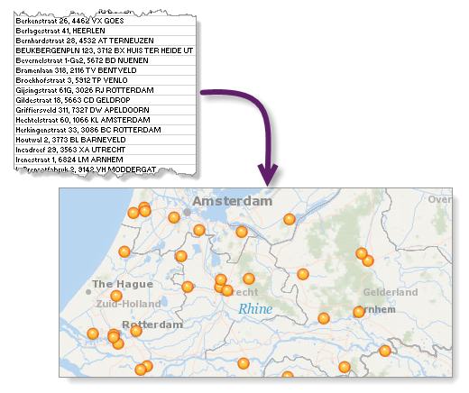
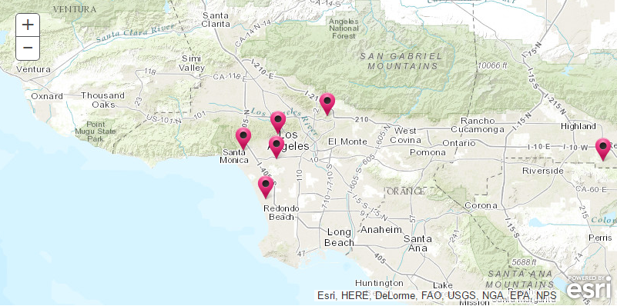
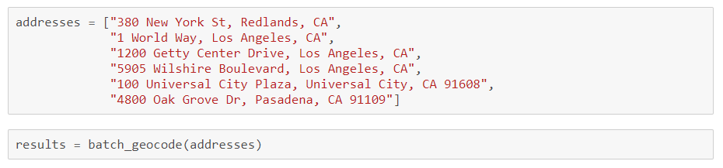
Batch Geocoding
Geocode an entire list of single line or multi field addresses

Slide 24
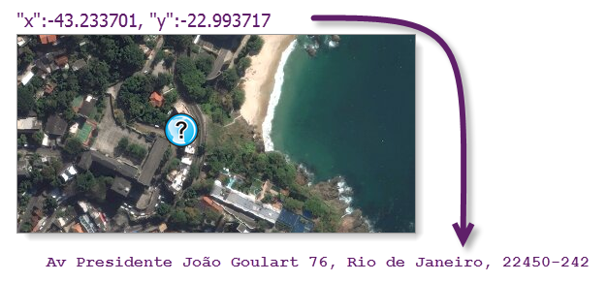
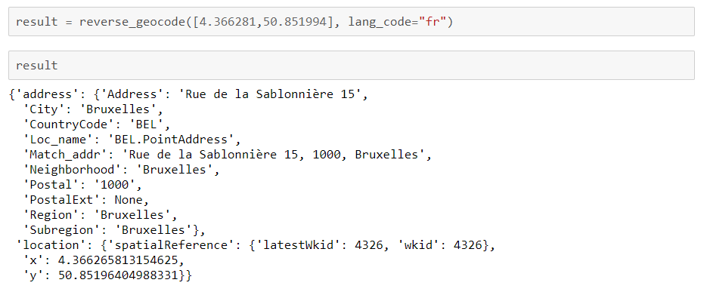
Reverse Geocode
Determines address at a particular x/y location

Slide 25
Network Analysis
Routing and directions, location allocation, service areas…
arcgis.network.analysis module

Slide 26
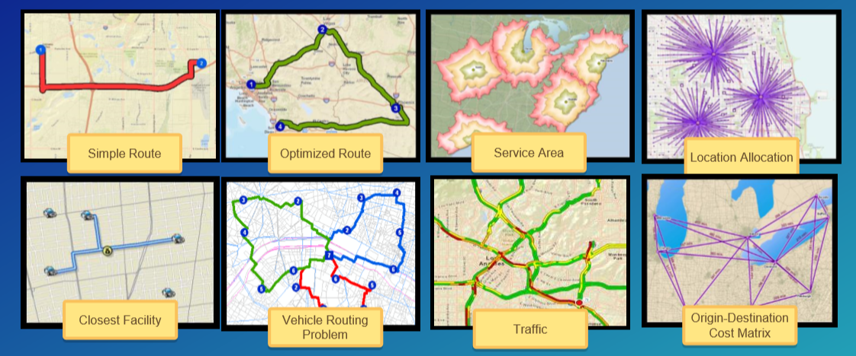
Network analysis capabilities and tools
Commercial grade, traffic aware routing and directions for multiple travel modes

Slide 27
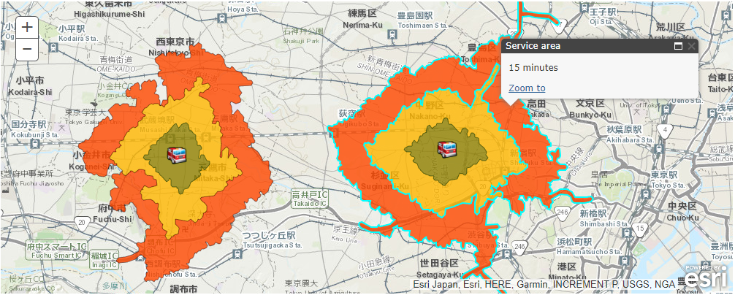
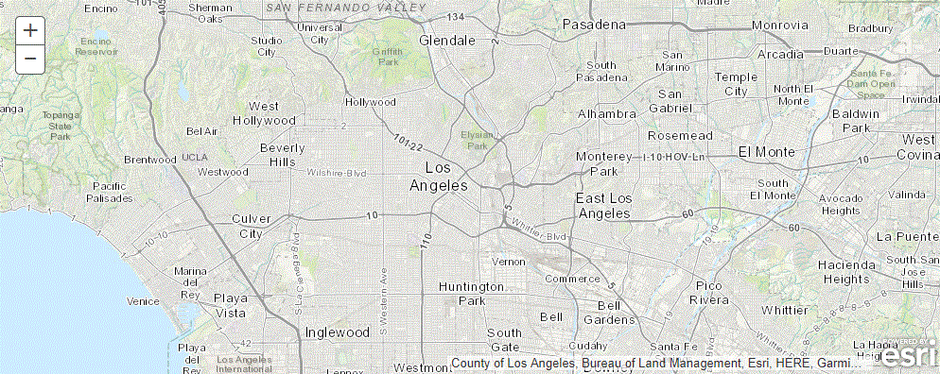
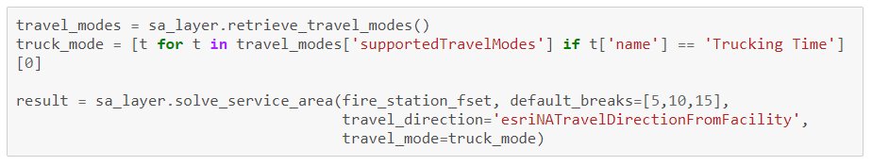
Network analysis – Service Areas

Slide 28
GeoEnrichment
Enrich your analysis with demographic and business data
arcgis.geoenrichment module

Slide 29
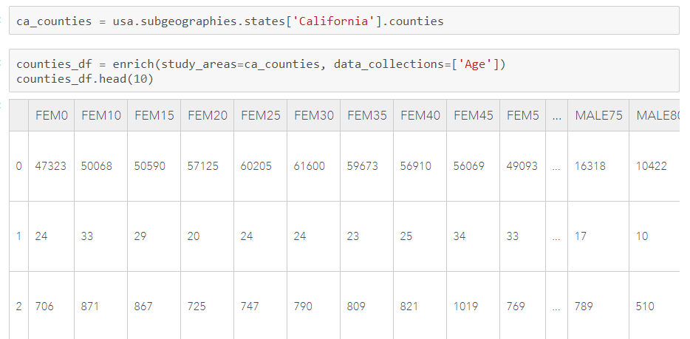
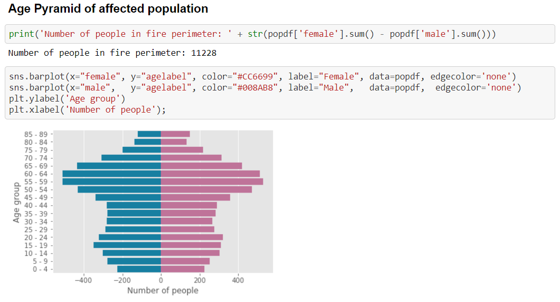
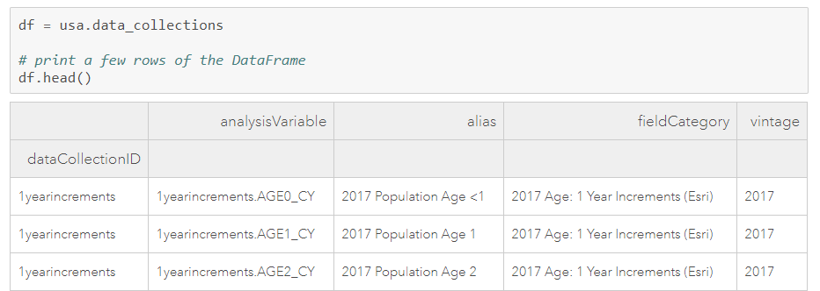
GeoEnrichment
Get facts about a location or area
Street addresses
Points, lines and polygon geometries
Within a drive time or service area
Named geographical areas
Counties or block groups in California
Districts and subdistricts in India
Create charts and choropleth maps

Slide 30
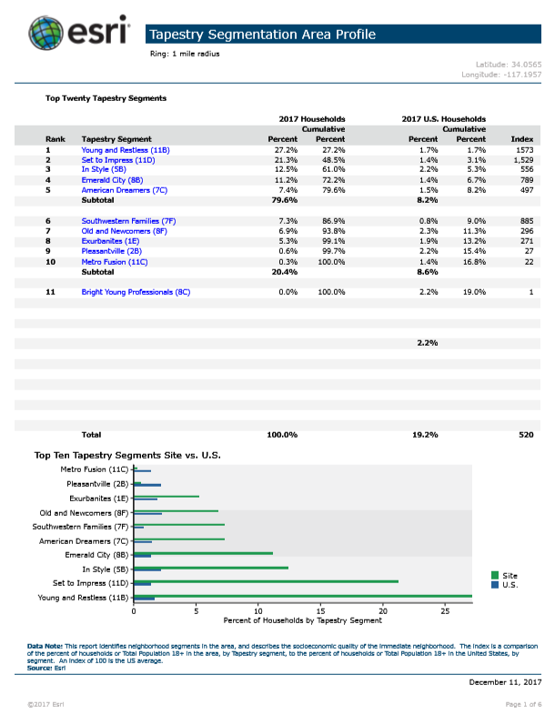
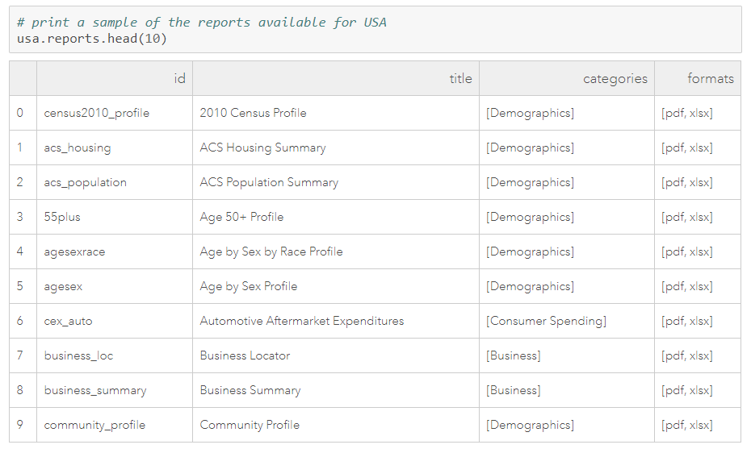
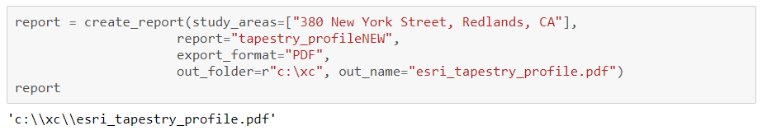
GeoEnrichment – create reports

Slide 31
Demo: GeoEnrichment

Slide 32
GeoAnalytics
Fast distributed spatio-temporal analysis of large vector and tabular data
arcgis.geoanalytics module

Slide 33
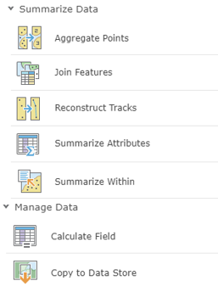
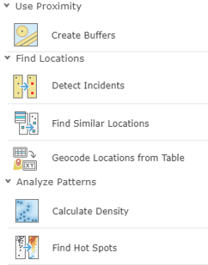
GeoAnalytics Tools
Summarize Data
Manage Data
Use Proximity
Find Locations
Analyze Patterns

Slide 34
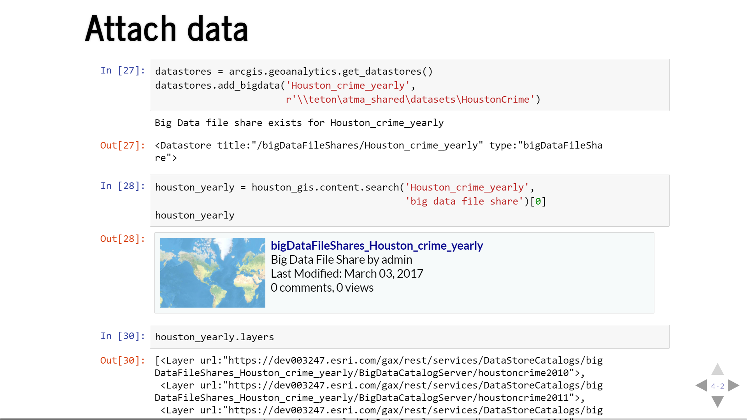

Slide 35
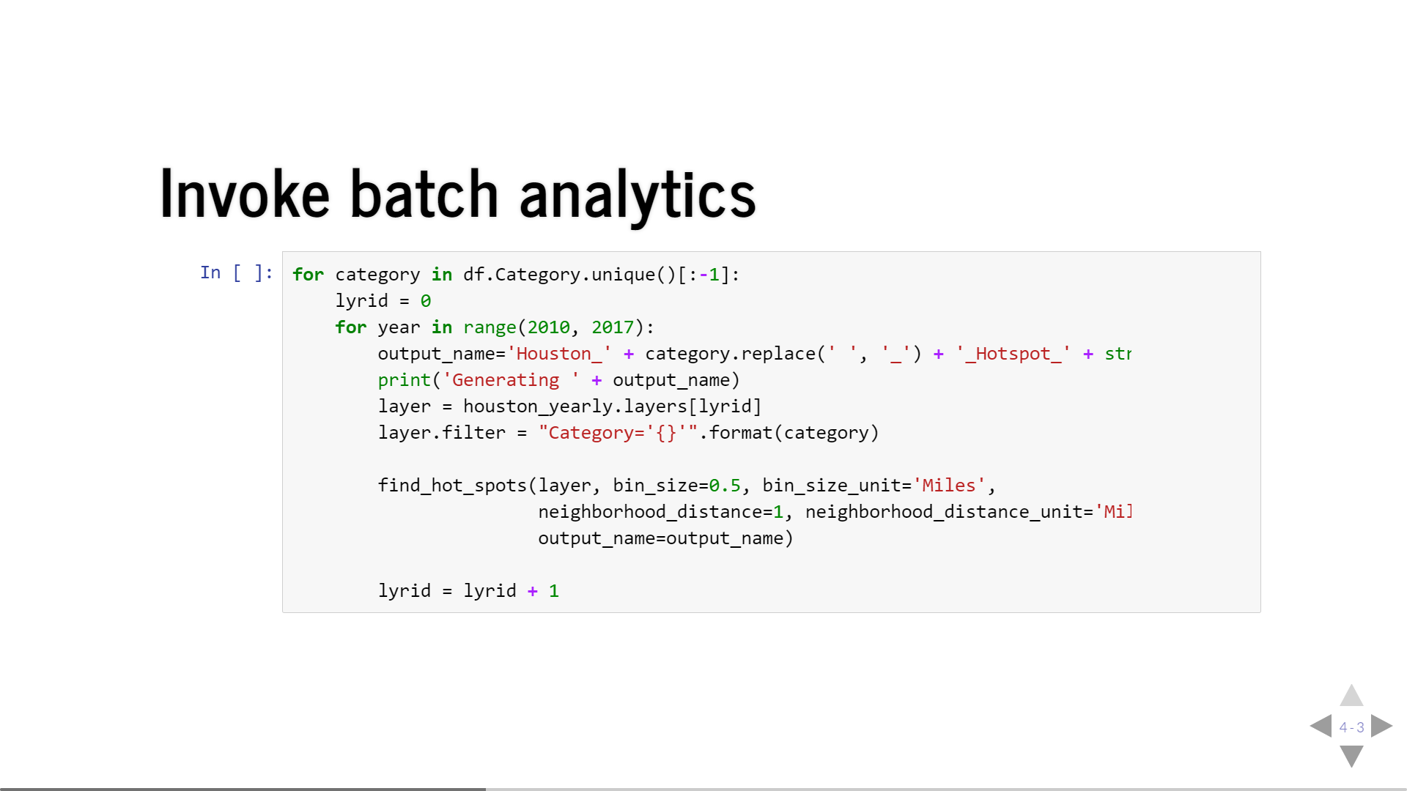

Slide 36
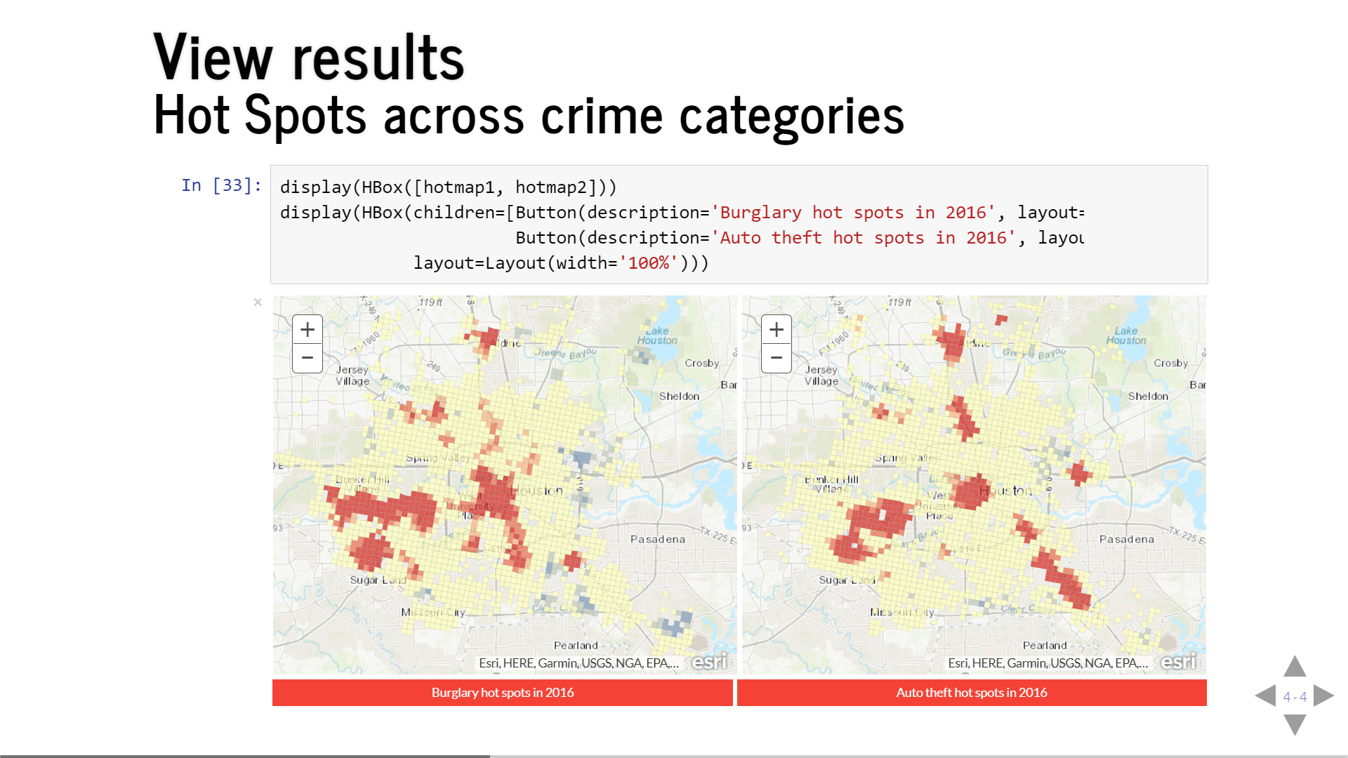

Slide 37


Slide 38
Spatial Data Frame
Feature layers as a Pandas dataframe
arcgis.features.SpatialDataFrame class

Slide 39

What is a Spatial Data Frame?
Built on Pandas
Easy to Update, Query and Add New Content
Quickly visualize data

Slide 40


Built to do Work!
FIONA
Shapely
Pyshp

Slide 41


Benefits of Spatial Data Frame
Packs large datasets into memory efficiently
Spatial Indexing
Consumes multiple data format
Small footprint with BIG results

Slide 42
Geometry Engine Support
ArcPy
Shapely
Data Reader Support
ArcPy
Fiona
pyshp

Slide 43
Demo: Flight Paths
Using Spatial DataFrame

Slide 44
Demo: Hot Spot Analysis
Using Spatial DataFrame

Slide 45
Alberto’s Slides
Using Tensor Flow, etc…

Slide 49
Data Science
Find the patterns hidden in data

Slide 50

Data Science with ArcGIS - Data
Esri curated content – Living Atlas
Multi-spectral, temporal, dynamic imagery layers
Landsat, NAIP, MODIS, Elevation
Basemaps, Imagery, Demographics, Transport
Boundaries & places, Landscape, Oceans
Earth Observations, Urban Systems, Historical Maps, …
Your data, org’s data, data shared with you
Shapefiles, File geodatabase, CSV, Excel, HTML, …
File shares, cloud share
HDFS, Hive and databases
Public data
Maps, layers and datasets shared by users worldwide

Slide 51








Data Science with ArcGIS - Visualization
Visualize with ArcGIS
Map widget in Jupyter notebook
Web Maps and Web Scene
Feature layers
Raster and imagery layer
Smart mapping
Pythonic renderers and symbology
Visualize with Python
Matplotlib, Seaborn, Bokeh, Plotly, …
Datashader, Holoviews, Mayavi, …

Slide 52


Data Science with ArcGIS - Analysis
Analysis with ArcGIS
Geoprocessing in Web GIS
Spatial analysis, Routing and directions
Network analysis, Geocoding, Geoenrichment…
Imagery and Raster Analysis
On the fly dynamic image processing
Distributed raster analysis
GeoAnalytics – large tabular and vector data

Slide 53


Data Science with ArcGIS - Analysis
Analysis with Python libraries
Data wrangling
Pandas, numpy, scipy
Machine learning
Scikit-learn, tensorflow, keras, pytorch, fastai
Geospatial analysis
PySAL, GDAL, Shapely, Fiona, …
Image processing and computer vision
PIL, OpenCV, scikit-image

Slide 54



Data Science workflows - Deployment
Deploy as information products
WebMaps
Web scenes
Layers
Deploy as web tools
Geoprocessing script tools
Binder projects
Deploy as dashboards
ArcGIS Operations Dashboard
Jupyter dashboard
Plotly dashboard

Slide 55
Questions?
Please fill out the surveys!

Slide 56






Please Take Our Survey in the Esri Events App
Download the Esri Events app and find your event
Select the session you attended
Scroll down to find the feedback section
Complete answers
and select “Submit”

Slide 57



